Slide 1
"Empowering Financial Security” Detecting Fraudulent Transactions
By Kajal Thakare

Slide 2
Introduction
Develop a machine learning model to detect potentially fraudulent transactions based on the provided features. The dataset contains information about various transactions, including account age, payment method, time of transaction, and category. The goal is to build a classification model that can accurately classify transactions as either legitimate or potentially fraudulent.

Slide 3
objective
Detecting Fraudulent Transactions using Advanced Machine Learning Techniques and Predictive Analytics"

Slide 4
Dataset Information
39221 rows and 8 columns
3200 duplicate values
Target variable is highly imbalanced 98.57% belongs to legitimate and 1.42% belongs to potentially fraudulent
No 0 variance column present
category and isWeekend columns are having blank values
In numItem column 95% of the dispersion belongs to 1 category
No multicollinearity
PaymentMethodAgeDays is having outliers
PaymentMethodAgeDays and accountagedays are not scaled

Slide 5
Data Dictionary
accountAgeDays:
This column is all about the number of the account days from the opening of the account .
numItems:
The number of items associated with the account.
LocalTime:
The local time at which the transaction was made. (ex: 4.745402 will be converted and understand as 4.44 AM) (timezone:24hrs)
PaymentMethod:
The method used for payment (e.g., PayPal, store credit, credit card).
PaymentMethodAgeDays:
The number of days since the payment method was associated with the account.(It indicates how long ago the current payment method (e.g., PayPal, credit card) was linked to the account.)the number of days since the payment method was first used by the user. This helps to determine the user's familiarity or trust with a specific payment method.
IsWeekend:
A binary indicator of whether the transaction occurred on a weekend (1 for yes, 0 for no).
Category:
The category of the transaction (e.g., electronics, shopping, food).
Label(Target column):
A binary label (0 for legitimate, 1 for potentially fraudulent).

Slide 6
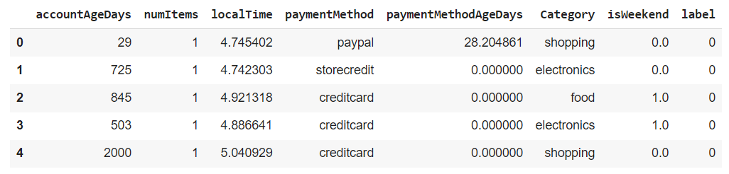
Libraries and reading the dataset
Imported basic libraries required for preprocessing and EDA part
(pandas, NumPy, matplotlib, seaborn and warnings)
Datafile reading and sample showing using pandas

Slide 7
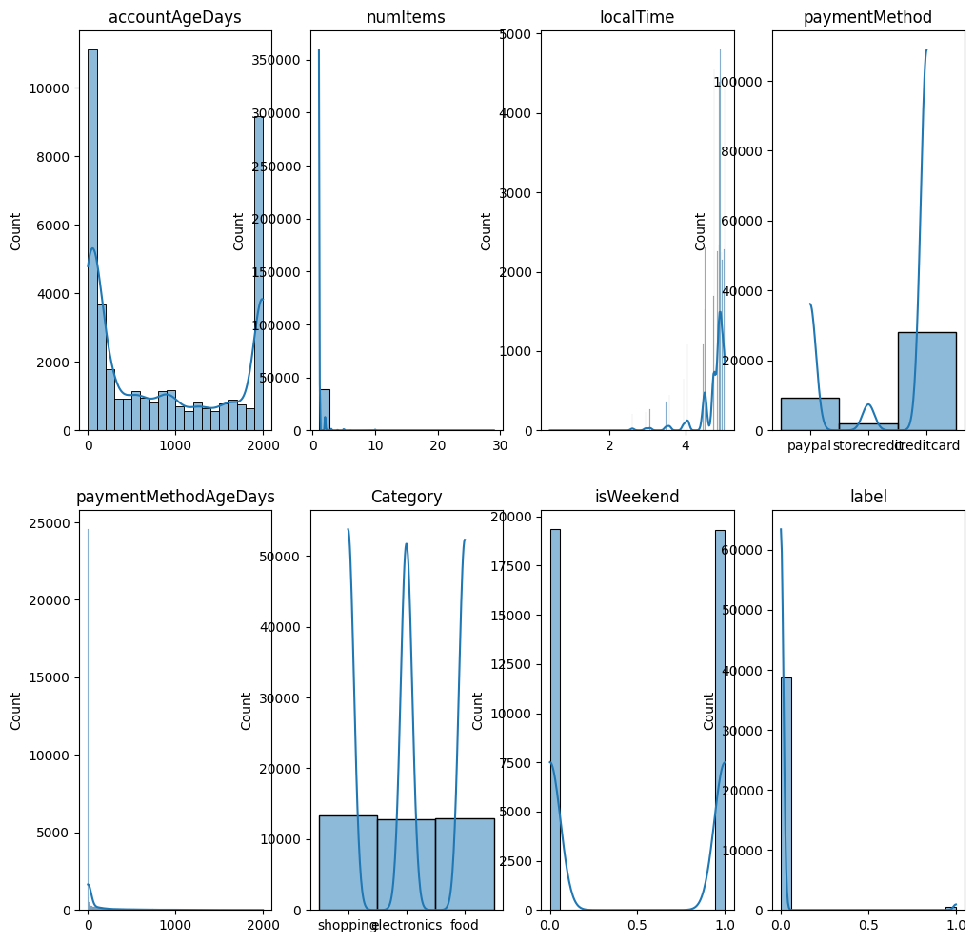
Dispersion of the dataset

Slide 8
Data Preprocessing
Data preprocessing is crucial for modelling this process prepare the data for the modelling. This step involves cleaning and transforming raw data into a format that is suitable for machine learning.
steps I have taken in data preprocessing:
Handling missing values
Removing outliers
Scaling features
Encoding categorical variables
Value count check
Duplicate check
Converted local time into 24hrs time frame

Slide 9
EDA (Exploratory Data Analysis)
EDA is all about understanding the data and gaining insights to inform modelling decisions. EDA focus on the visualizations and statistical techniques
Steps taken in the EDA part :
Multicollinearity
Data dispersion
Outlier detection

Slide 10
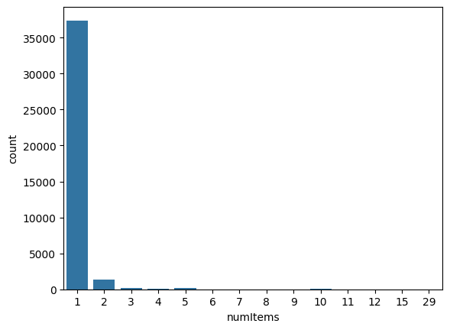
Numitems column data dispersion

Slide 11
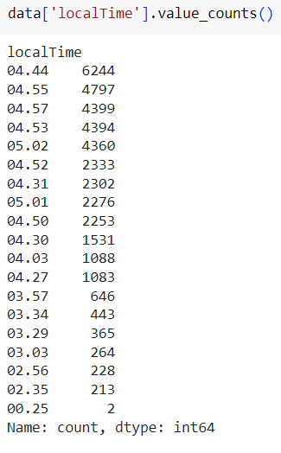
localTime value count
The time hours for the dataset are between 12 am. To 5.02 am.
The time between 4 am. To 5.02 am. This one hour contains 80% of the data.
This introduce bias in the dataset
Did model building using the local time column but didn’t get the desired output
The final model is build without the localTime column

Slide 12
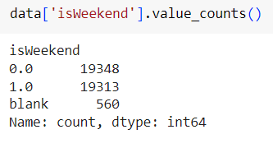

N/a values Imputation
All the potentially fraudulent transactions are detected where the isWeekend column value is n\a
Imputation with mean or mode or deletion of n\a rows would be not suitable approach
Fill the n\a values with ‘blank’ word and then do the further processing
Category column is categorical data – using mode is ideal for this

Slide 13
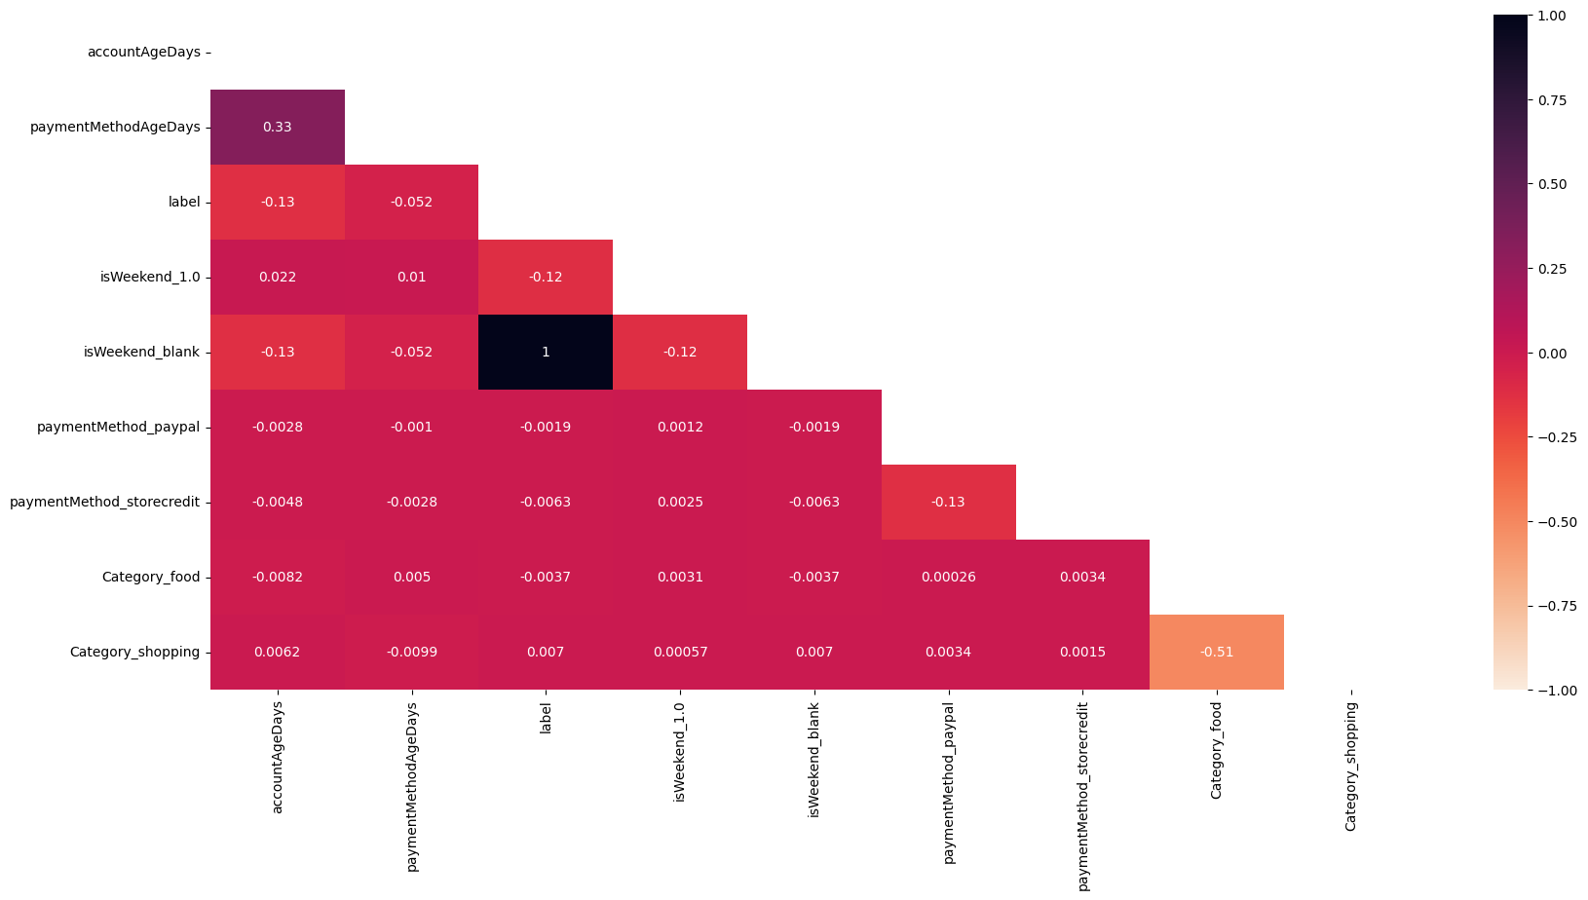
Multicollinearity

Slide 14
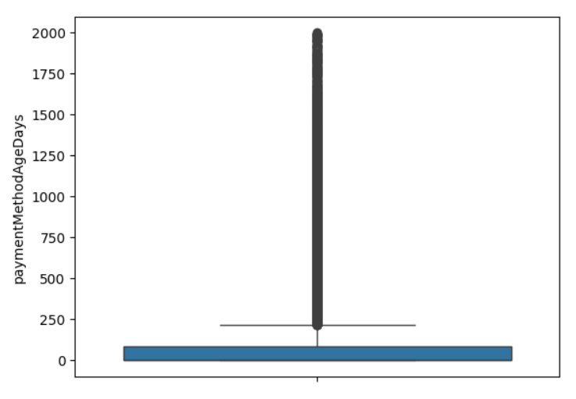
Outlier Imputation
paymentMethodAgeDays column contain outliers imputed them with the help of the IQR method

Slide 15
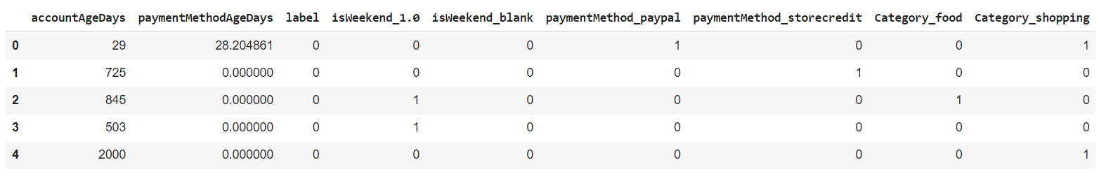
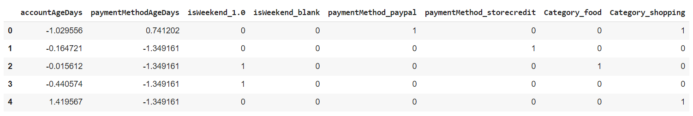
Scaling using standard scaler
Standard scaler is a technique used to transform features by scaling them to have a mean of 0 and a standard deviation of 1. It helps the algorithms to improve the performance

Slide 16
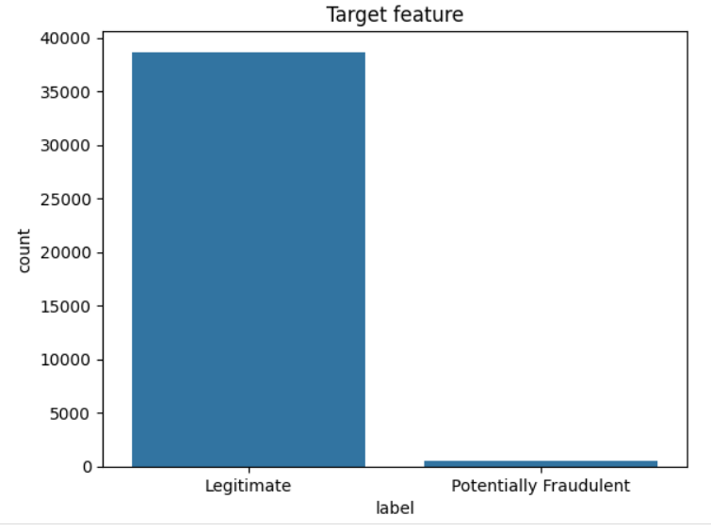
Oversmapling
Target variable is highly imbalanced
Balancing the variable With the help of
SMOTE oversampling
SMOTE generates synthetic samples for the
minority class instances

Slide 17
Model Building

Slide 18
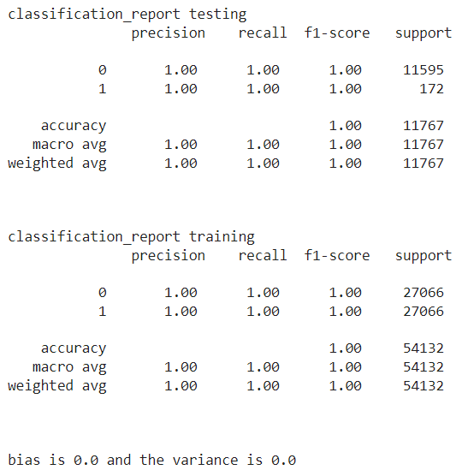
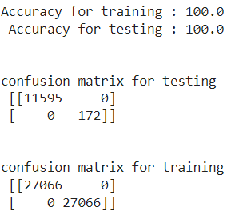
Logistic Regression
Logistic Regression :
Logistic Regression is a statistical method used for binary classification problems, where the outcome can take one of the two possible values, often represented as 0 or 1. it estimates the probability that a given input belongs to a certain category

Slide 19
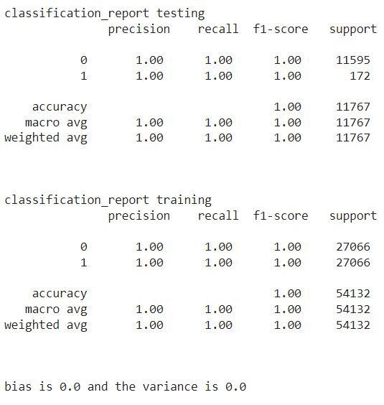
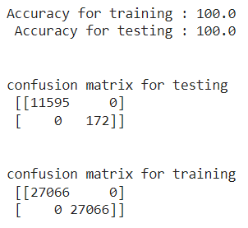
Random Forest
Random forests or random decision forests is an ensemble learning method for classification, regression and other tasks that operates by constructing a multitude of decision trees at training time. For classification tasks, the output of the random forest is the class selected by most trees.

Slide 20
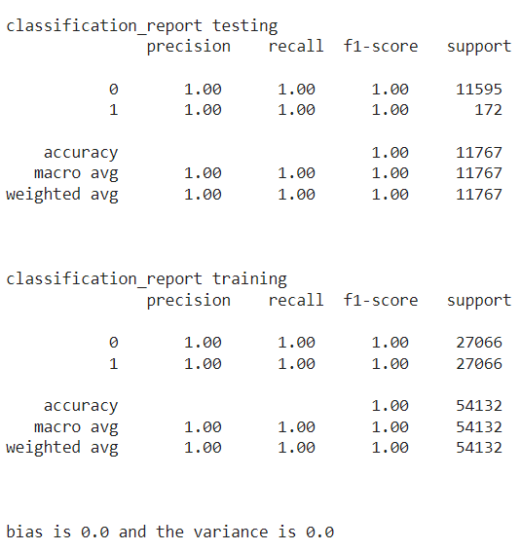
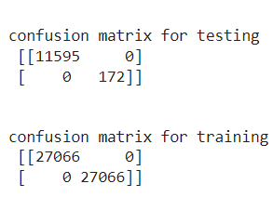
XG-Boost
XGBoost, which stands for Extreme Gradient Boosting, is a scalable, distributed gradient-boosted decision tree (GBDT) machine learning library. It provides parallel tree boosting and is the leading machine learning library for regression, classification, and ranking problems.

Slide 21
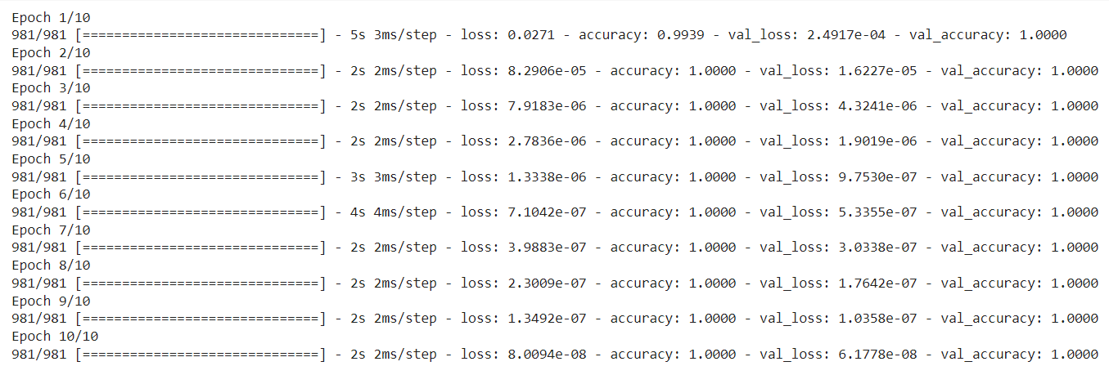
Early Stopping
Early stopping is a regularization technique that stops training if, for example, the validation loss reaches a certain threshold.

Slide 22
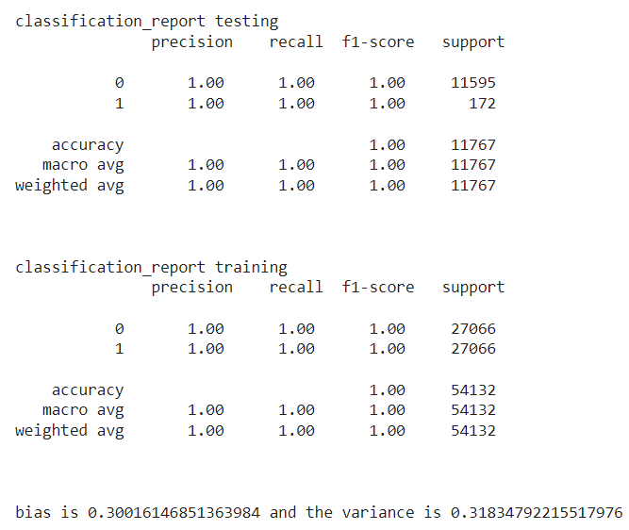
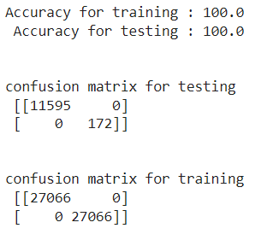
SVM
A support vector machine (SVM) is a supervised machine learning algorithm that classifies data by finding an optimal line or hyperplane that maximizes the distance between each class in an N-dimensional space.

Slide 23
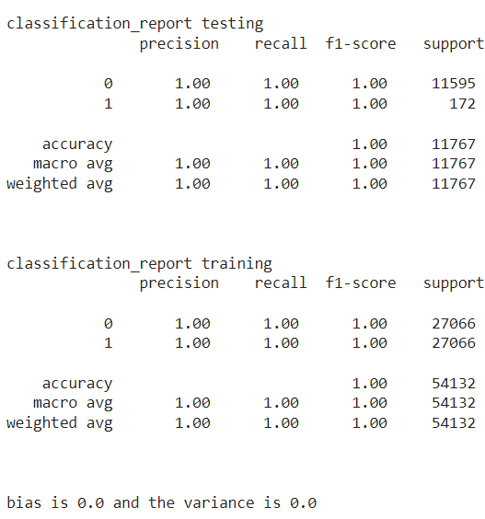
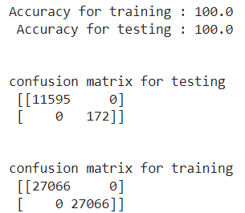
Naïve Bayes
A Naive Bayes classifiers, a family of algorithms based on Bayes’ Theorem. The advantage of using naïve Bayes is its speed. It is fast and making prediction is easy with high dimension of data. This model predicts the probability of an instance belongs to a class with a given set of feature value. It is a probabilistic classifier. It is because it assumes that one feature in the model is independent of existence of another feature. In other words, each feature contributes to the predictions with no relation between each other.

Slide 24
Findings from the dataset
All potentially fraudulent transactions are having values from the columns accountAgeDays == 1 and isWeekend == blank
localTime columns values i.e. hours are within the 12 am. To 5.30 am.
numItems values
Dataset is giving 100% accurate predictions and there is no overfitting
Every algorithm I used is giving 100% accuracy and 1.0 precession, recall and F1 score
Hyperparameter tunning, regularization and early stopping methods are also giving the same output as the algorithms
isWeekend_blank is highly correlated with target column
There is balanced between the bias and variance

Slide 25
Thank you

